Slide 1
ARTIFICIAL INTELLIGENCE & MACHINE LEARNING
Session no: 3
Topic: INFORMED SEARCH-INTRODUCTION TO Heuristic Search

Slide 2
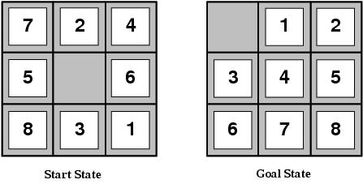
Limitations of uninformed search
Search Space Size makes search tedious
Combinatorial Explosion
For example, 8-puzzle
Avg. solution cost is about 22 steps
branching factor ~ 3
Exhaustive search to depth 22:
3.1 x 10¹⁰ states
E.g., d=12, IDS expands 3.6 million states on average
[24 puzzle has 10²⁴ states (much worse)]

Slide 3
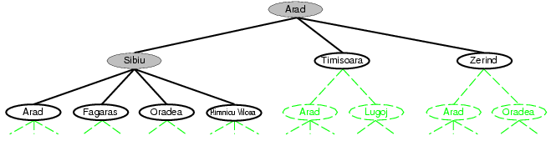
Recall tree search…

Slide 4
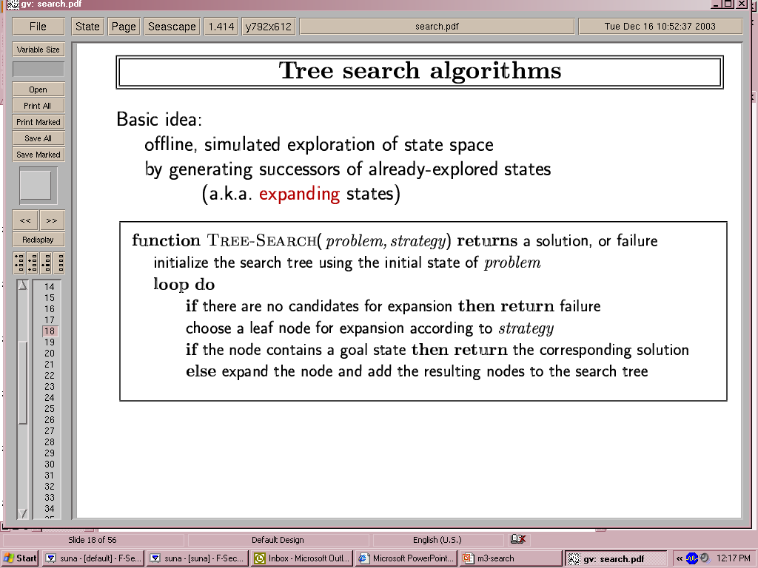
Recall tree search…
This “strategy” is what differentiates different search algorithms

Slide 5
Heuristic Search
All of the search methods in the preceding section are uninformed in that they did not take into account the cost incurred to reach the goal.
They do not use any information about where they are trying to get to unless they happen to stumble on a goal.
A heuristic is a method that improves the efficiency of the search process.
To find a solution in proper time rather than a complete solution in unlimited time we use heuristics.
These heuristic search methods use heuristic functions to evaluate the next state towards the goal state
A heuristic function h(n), takes a node n and returns a non-negative real number that is an estimate of the cost of the least-cost path from node n to a goal node.

Slide 6
Heuristic search
Idea: use an evaluation function f(n) for each node
and a heuristic function h(n) for each node
g(n) = known path cost so far to node n.
h(n) = estimate of (optimal) cost to goal from node n.
f(n) = g(n)+h(n) = estimate of total cost to goal through node n.
f(n) provides an estimate for the total cost:
Expand the node n with smallest f(n).
Implementation:
Order the nodes in frontier by increasing estimated cost.
Evaluation function is an estimate of node quality
More accurate name for “best first” search would be “seemingly best-first search”
Search efficiency depends on heuristic quality!
The better your heuristic, the faster your search!

Slide 7
Heuristic function
Heuristic:
Definition: a commonsense rule (or set of rules) intended to increase the probability of solving some problem
Same linguistic root as “Eureka” = “I have found it”
“using rules of thumb to find answers”
Heuristic function h(n)
Estimate of (optimal) remaining cost from n to goal
Defined using only the state of node n
h(n) = 0 if n is a goal node
Example: straight line distance from n to Bucharest
Note that this is not the true state-space distance
It is an estimate – actual state-space distance can be higher
Provides problem-specific knowledge to the search algorithm

Slide 8
Heuristic functions for 8-puzzle
8-puzzle
Avg. solution cost is about 22 steps
branching factor ~ 3
Exhaustive search to depth 22:
3.1 x 10¹⁰ states.
A good heuristic function can reduce the search process.
Two commonly used heuristics
h₁ = the number of misplaced tiles
h₁(s)=8
h₂ = the sum of the distances of the tiles from their goal positions (Manhattan distance).
h₂(s)=3+1+2+2+2+3+3+2=18

Slide 9
Relationship of Search Algorithms
g(n) = known cost so far to reach n
h(n) = estimated (optimal) cost from n to goal
f(n) = g(n) + h(n)
= estimated (optimal) total cost of path through n to goal
Uniform Cost search sorts frontier by g(n)
Greedy Best First search sorts frontier by h(n)
A* search sorts frontier by f(n)
Optimal for admissible/consistent heuristics
Generally the preferred heuristic search
Memory-efficient versions of A* are available
RBFS, SMA*

Slide 10
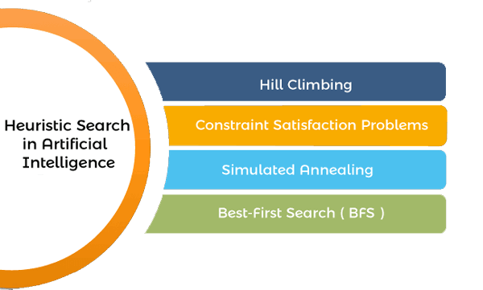
Heuristic search techniques in AI

Slide 11
Summary
Uninformed search methods have uses, also severe limitations
Heuristics are a structured way to add “smarts” to your search
Informed (or heuristic) search uses problem-specific heuristics to improve efficiency
Best-first, A* (and if needed for memory limits, RBFS, SMA*)
Techniques for generating heuristics
Can provide significant speed-ups in practice
E.g., on 8-puzzle, speed-up is dramatic
Still have worst-case exponential time complexity
In AI, “NP-Complete” means “Formally interesting”

Slide 12
Reference Books:
1. Russel and Norvig, ‘Artificial Intelligence’, third edition, Pearson Education, PHI, (2015)
2. Elaine Rich & Kevin Knight, ‘Artificial Intelligence’, 3nd Edition, Tata Mc Graw Hill Edition, Reprint( 2008)
Sites and Web links:
https://www.virtusa.com/digital-themes/heuristic-search-techniques
https://towardsdatascience.com/a-star-a-search-algorithm-eb495fb156bb
https://www.tutorialandexample.com/local-search-algorithms-and-optimization-problem/
http://cgi.di.uoa.gr/~ys02/siteAI2008/local-search-2spp.pdf
http://aima.eecs.berkeley.edu/slides-pdf/chapter04b.pdf

